Slide 1


Python: Crash Course
Darth Vader
Notes:
Windows python libs MSI: http://www.lfd.uci.edu/~gohlke/pythonlibs/

Slide 2
whoami
ID = {
"name" : "Enrique E. Nissim",
“age" : 24,
“profession" : "Information System Engineering",
“description" : ["Infosec enthusiast", "Exploit Writer Tester SSr at Core Security", "Offensive Security Certified Professional", "I Like to code tools, reverse stuff & find bugs ☺“],
“twitter" : "@kiqueNissim",
"website" : "http://www.movediedi.com.ar/"
}

Slide 3
Agenda
Strings
Set Operations
Comprhension
Some builtins
*args, **kwargs
Iterators
Generators
Closures
Decorators
Classes: inheritance, attributes, methods
GRASP
GoF Design Patterns: Factory, Singleton, Facade, Composite, Observer, State
Types and Objects
Metaclasses

Slide 4
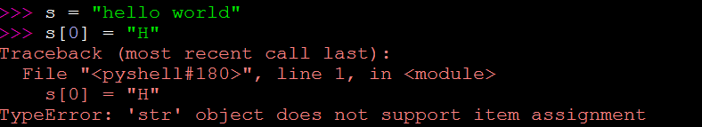
Strings
A string is an inmmutable sequence of one-character strings.

Slide 5
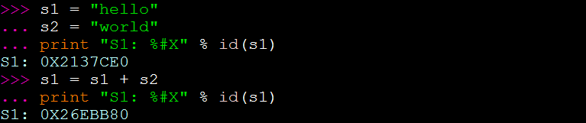
Strings Immutability
This is the way:
Notes:
Someone can tell me why python uses immutability on strings?

Slide 6
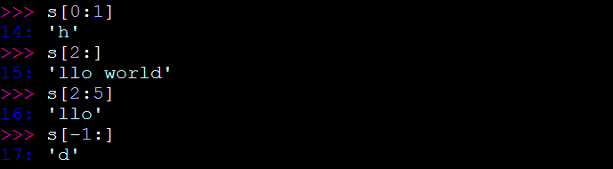
Strings Slicing
Slicing: s[begin:end:step]
Substrings through slice:
Reverse:

Slide 7
Split and join
split() will divide the sequence and insert each element into a list
join() takes a list of strings as input and returns a new string made of each element of the list.

Slide 8
Exercise
Given the string:
“the quieter you become, the more you are able to hear”
Use python to transform the first letter of each word to upper case.

Slide 9
Set Operations
The set module provides classes for constructing and manipulating unordered collections of unique elements.
Common Operations:
Union
Intersection
Difference
XOR
Cartessian Product

Slide 10
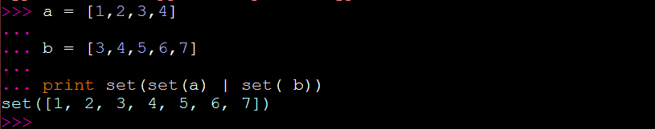
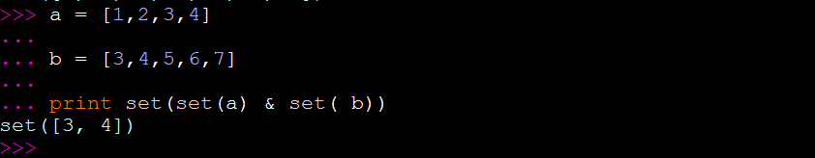
Union
Intersection

Slide 11
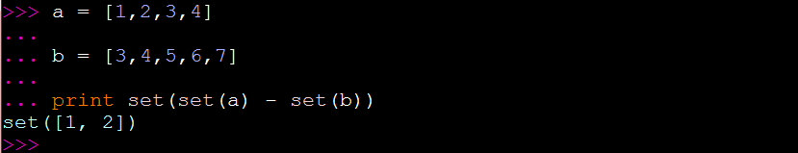
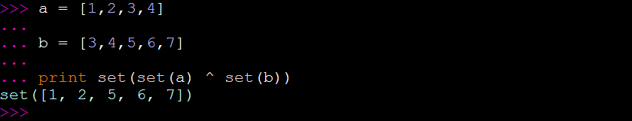
Difference
XOR

Slide 12
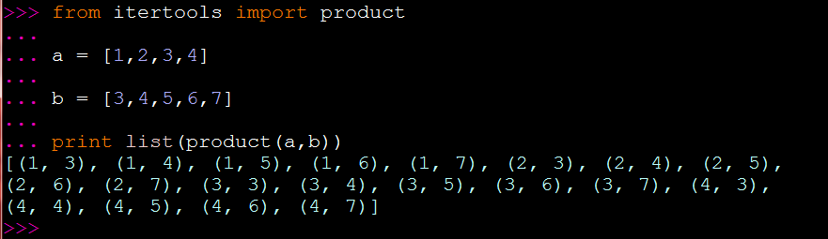
Cartessian Product

Slide 13
Comprehensions
List comprehensions provide a concise way to create lists.
Common applications are to make new lists where each element is the result of some operations applied to each member of another sequence or iterable, or to create a subsequence of those elements that satisfy a certain condition.

Slide 14
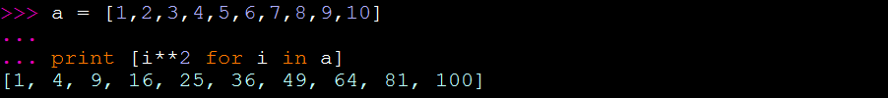
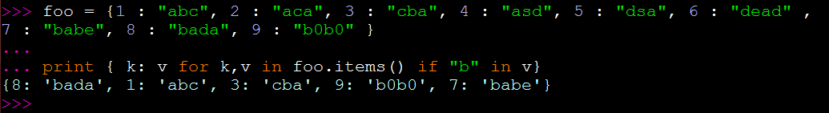
List Comprehension
DICT Comprehension
Notes:
Ejercicio: dado un texto arbitrario, convertir la primera letra de cada palabra en mayuscula

Slide 15
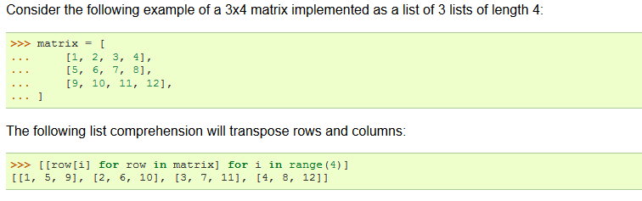
Another Example
https://docs.python.org/2/tutorial/datastructures.html

Slide 16
Filters
Comprehension Way
Using filter

Slide 17
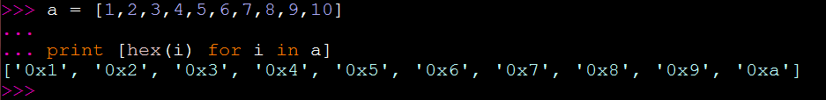
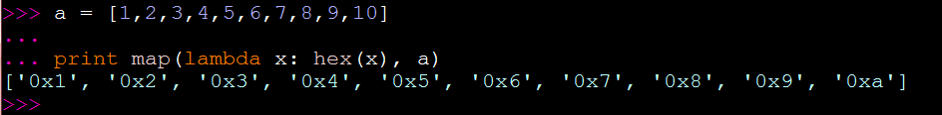
MAP
Comprehension Way
Using map

Slide 18
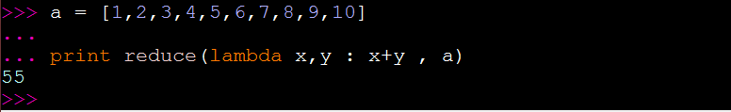
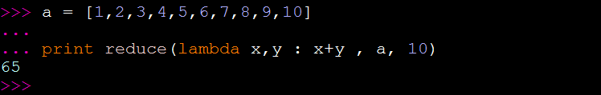
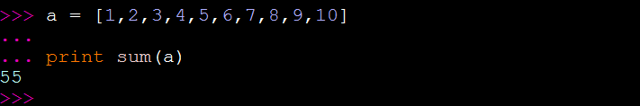
Reduce
SUM

Slide 19
Reduce?
Common usages?
Ok maybe not…
reduce(lambda hold,next:hold+chr(((ord(next.upper())-65)+13)%26+65),'znlorabggbbhfrshy','')

Slide 20
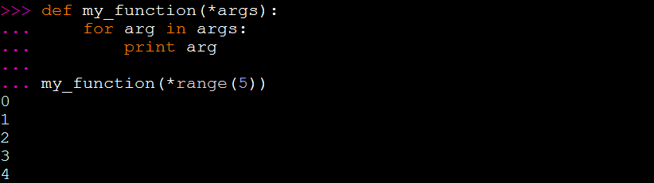
*ARGS
*args definitions are used ot pass a variable number of arguments to a function.

Slide 21
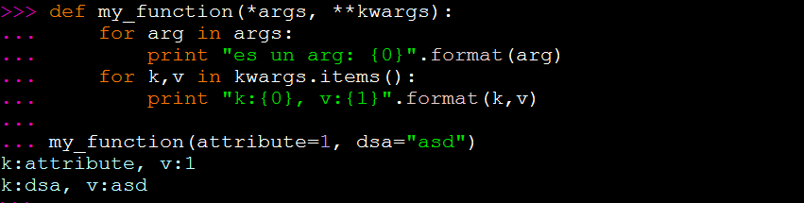
**KWARGS
**kwargs allows you to handle named arguments that you have not defined in advance

Slide 22
Iterators
Most of the code that use sequences can be placed in one of two categories:
Those that use the sequence as a whole
Those that just need the items within the sequence
Not all sequences need to be loaded in their entirety in advance. Eg: set of positive integers, the fibonacci sequence, etc.

Slide 23
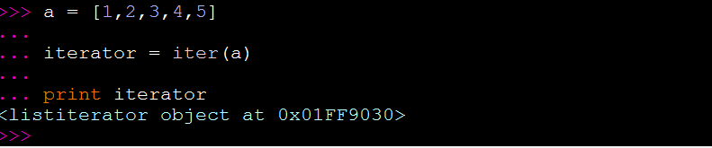
ITERATORS
An Iterator is an object which can be iterated upon, and which will return one element at a time.
An object is called Iterable if we can get an iterator from it (lists, tuples, strings, etc.). The iter() function (which then calls the __iter__() method), returns an iterator from them.

Slide 24
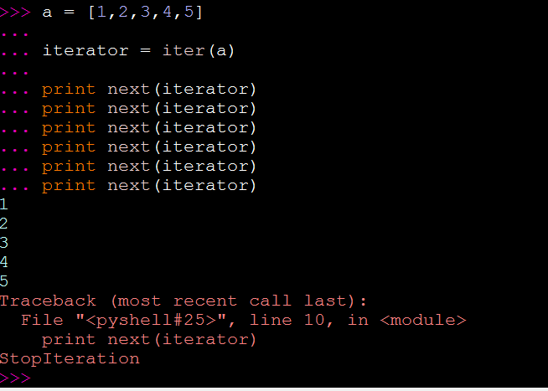
Iterators
An iterator object must implement two special methods:
__iter__()
__next__()
This is called the Iterator Protocol

Slide 25
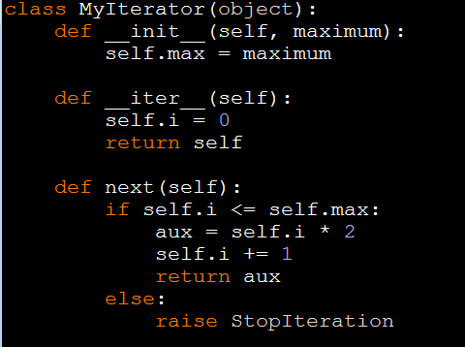
ITERATORS
The for loop automatically creates an iterator object by calling iter() over the iterable object.

Slide 26
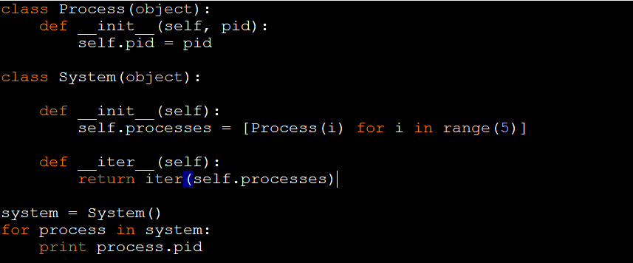
ITERATOR Example

Slide 27
Generators
A generator is function that returns an object (iterator) which we can iterate over.
Python generators are a simple way of creating iterators
If a function contains a yield statement, it becomes a generator function.
Both yield and return will return some value from a function. The difference is that, while a return statement terminates a function entirely, yield statement pauses the funciton saving all its sates and later cotinues from there on successive calls.
Yield is both the exit and entry point for the generator

Slide 28
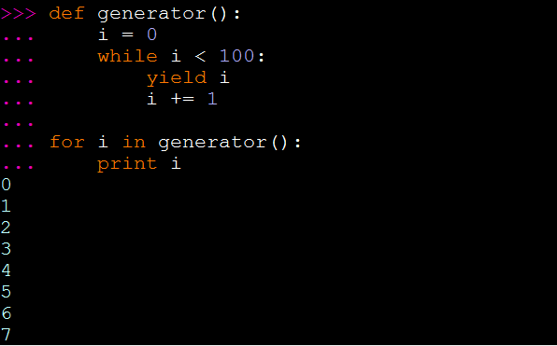
GENERATORS

Slide 29
GENERATORS
What happens if you iterate over the generator twice?...
You will get an error saying you tried to pass in an empty sequence. A generator doesn’t contain all the values, it just iterates over them when asked to do so. The generator doesn’t restart.

Slide 30
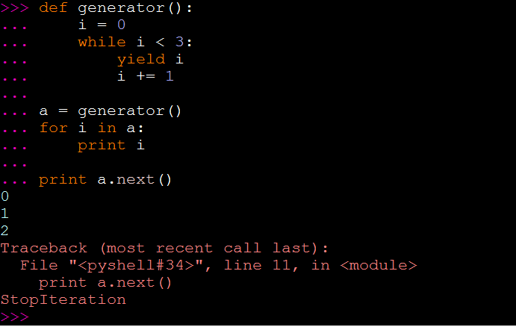
GENERATORS

Slide 31
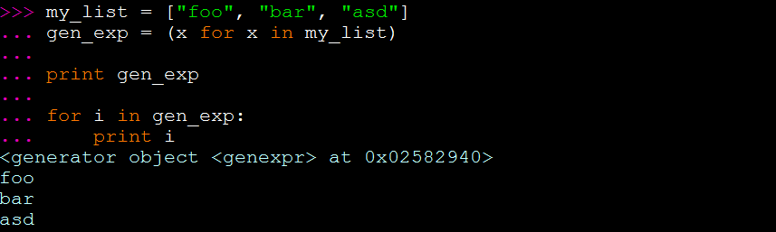
Generator Expressions
It’s another way of creating a generator.
The syntax is very similar to that of a list comprehension

Slide 32
Why Use generators?
Far easier to implement than the iterator protocol
Memory Efficient
Represent Infinite Stream

Slide 33
Exercise
Create a generator of the fibanacci sequence

Slide 34
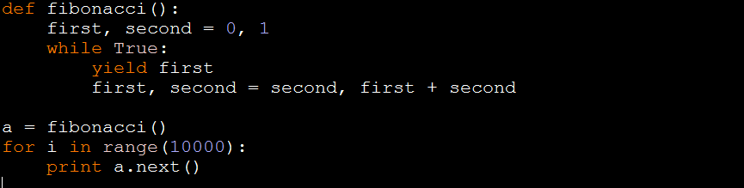
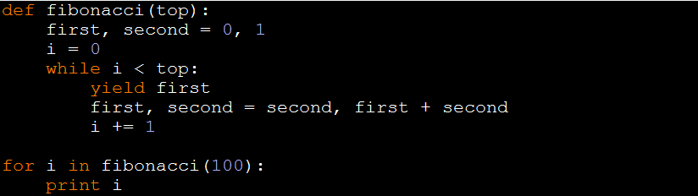
Solution

Slide 35
Closures
CLOSURE:
A closure is a function that’s defined inside another function, but is then passed outside that function where it can be used by other code.
When to use a closure?
When you need to write a complicated generator.
Monkey patch a function you can’t change.
Dynamically build behavior by “stacking” functions. (Decorator Design Pattern)

Slide 36
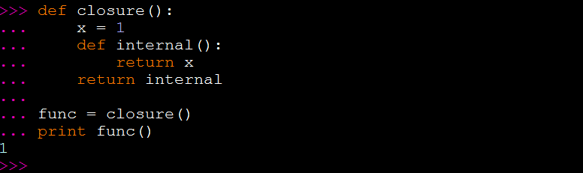
Closure Example

Slide 37
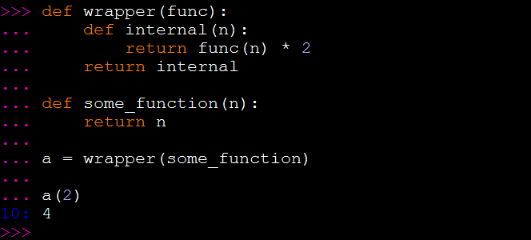
Decorators
Decorators allow you to weave functionality into your existing code without actually modifying it.
A Decorator takes a function as argument and returns replacement function

Slide 38
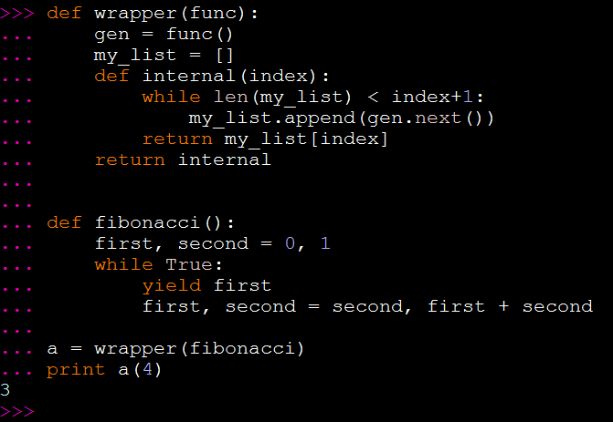
Example

Slide 39
Exercise
Create a generator able to generate all positive integers
Create a wrapper over the generator (using a decorator) to only return prime numbers

Slide 40
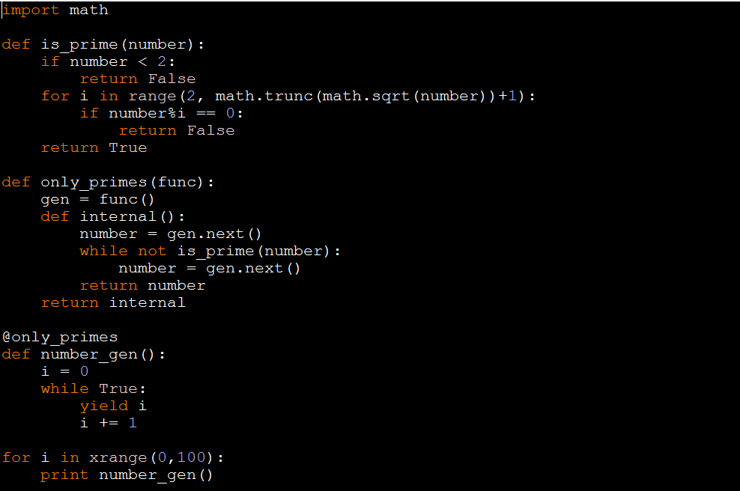
Solution

Slide 41
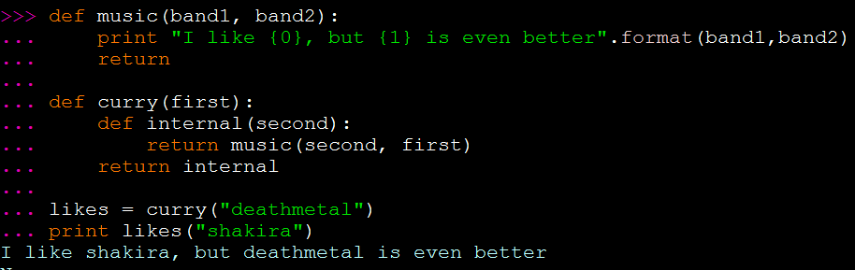
Currying
Currying is the technique of translating the evaluation of a function that takes multiple arguments into evaluating a sequence of functions, each with a single argument (partial application).

Slide 42


Slide 43
What is OOP?
Everithing is an object
Computation is performed by objects communicating with each other by sending and receiving messages
Each object has its own memory (state), which consists of other objects
Every object is an instance of a class
The class is the repository for behavior. All instances of the same class can perform the same actions.
Classes are organized into a single rooted tree, called the inheritance hirarchy.
The OOP Manifest (Alan Kay, 1993)

Slide 44
Classes
Although functions allow you to define code that can be reused, it’s often more useful to combine those functions into logical groupings that define the behavior of a particular type of object.
Classes are a way to define components that reflect real objects in a program’s domain.
Python implements object-oriented programming by way of classes (types)
A class encapsulates the behavior of an object, while an instance of the class represents the data for the object. Therefore, even though data may change from one instance to another, behavior determined by the underlying class will remain the same across those instances.

Slide 45
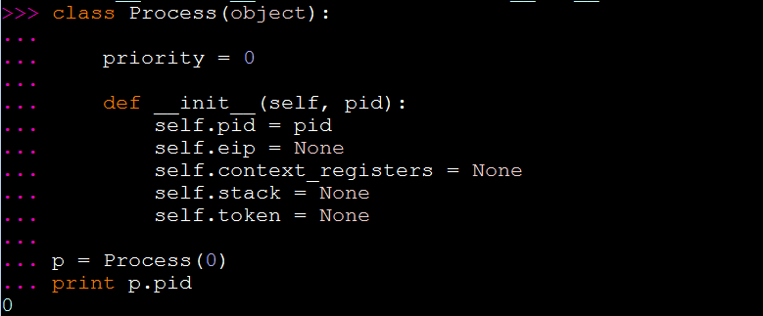
Class Example

Slide 46
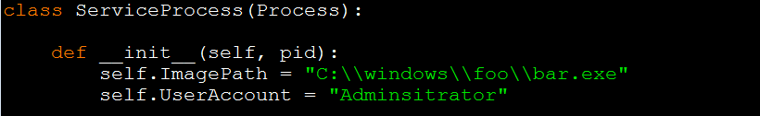
Inheritance
Python allows each class to specify one or more base classes that will provide the fundamental behavior.
The new class being defined can add new behavrios or override any existing ones.
By default, all objects descend from the built-in object type.

Slide 47
NAMESPACES and Attributes
A namespace is a mapping from names to objects, with the property that there is zero relation between names in different namespaces.
Classes and Instances define new namespaces
When you try to access an attribute from an instance of a class, it first looks at its instance namespace, then it looks at the class (the object’s type) namespace, and then at the inheritance chain (bases).
If the search of an attribute fails, Python raises an AttributeError exception.
Attributes reside inside a dictionary __dict__ in the object.
__dict__ is an attribute provided by python
__dict__ contains only the user-provided attributes.
Notes:
We’re not going to talk about descriptors in this class ☺

Slide 48
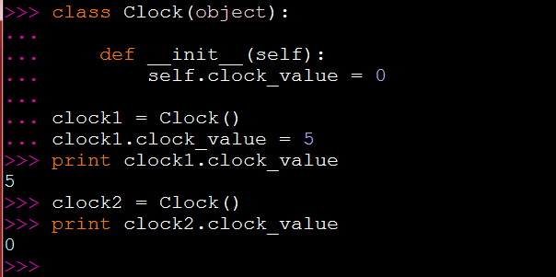
Instance Attributes
Every instance receives its own set of attributes:

Slide 49
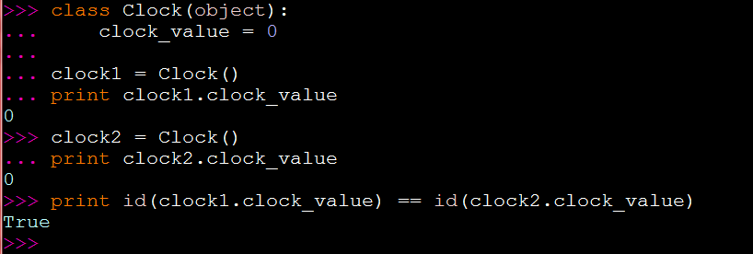
Class Attributes
In this case attributes are bound to the class and not a particular instance.

Slide 50
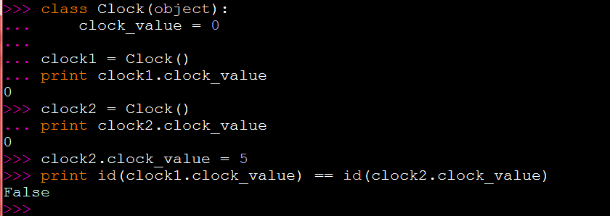
Class Attribute?
What happens if an instance overwrites the value of a class attribute?

Slide 51
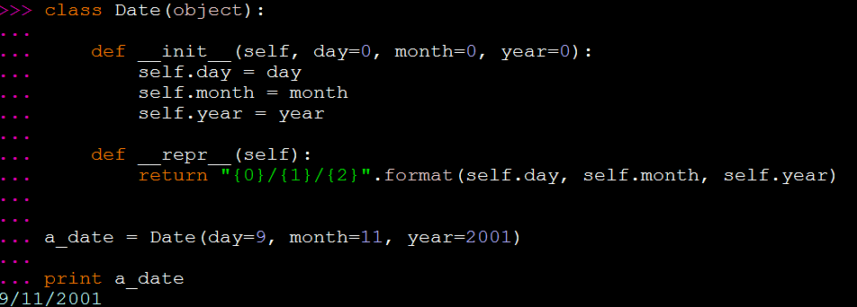
Class Methods
Sometimes we need to process data not related to an instance but to the class itself.
These methods will receive a class object as the first argument.
Example:
Notes:
http://stackoverflow.com/questions/12179271/python-classmethod-and-staticmethod-for-beginner

Slide 52
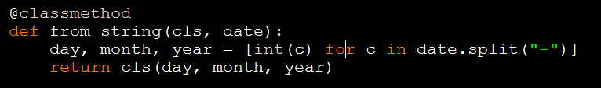

Class Methods
Now, we want to create Date instances having date information coming from outer source encoded as a string (‘mm-dd-yyy’).
Contrary to C++, which has method overloading feature, we can’t define a new __init__(), but we can use @classmethod instead and create another constructor:

Slide 53
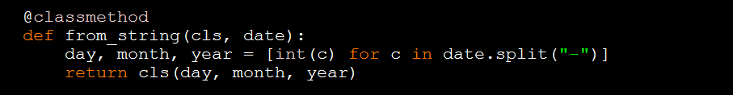
Static Methods
These ones are functions with no self and no class arguments.
They can’t work with instance attributes (but they can with class attributes)
Can be called from both: classes and instances
Example: we want to be able to validate a date. This task is logically bound to Date class, but it doesn’t require instantiation from it.

Slide 54
__init__
The construction of an object can be diveded in two parts:
Allocation of memory
Initialization
__init__ is the most commonly used operator overloading method in Python. It is used to initialize the newly created instance object using any arguments passed to the class name.

Slide 55
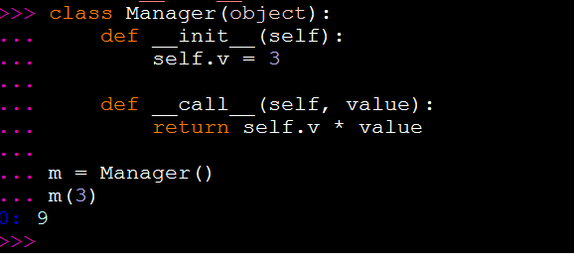
__call__
The __call__ method is called when the instance is called.

Slide 56
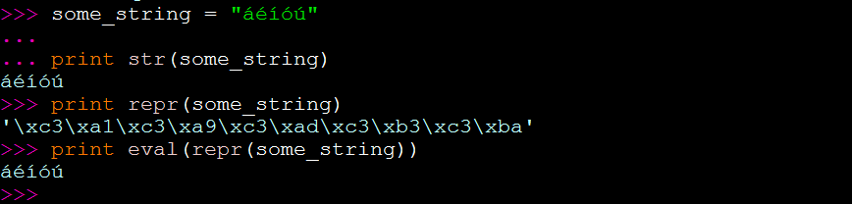
__REPR__ & __STR__
__repr__ goal is to be unambigous. It is used to compute the official string representation of an object.
__str__ goal is to be readable. It is used to compute the informal string representation of an object.
Being the “official representation” means that the object can be reconstructed from the string.

Slide 57
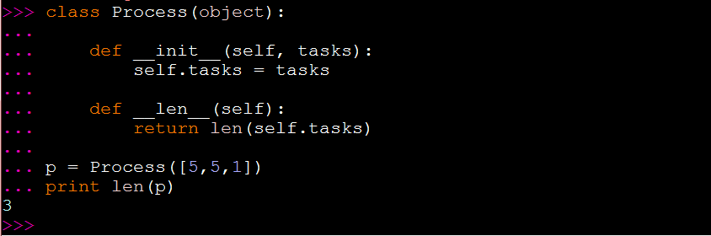
__len__

Slide 58

Object oriented Analysis and design

Slide 59
Object oriented Analysis
The goal of the analysis phase is to create a model of the system.
In object-oriented analysis, we need to identify and describe the concepts of the problem domain:
Identify the objects
Describe how the objects interact

Slide 60
Domain Model
A domain model in problem solving and software engineering is a conceptual model of all the topics related to a specific problem.
It describes the various entities, their attributes, roles, and relationships, plus the constraints that govern the problem domain.
Common mistake:
Represent a something as an attribute while it should be represented as a concept.
Wikipedia: http://en.wikipedia.org/wiki/Domain_model

Slide 61
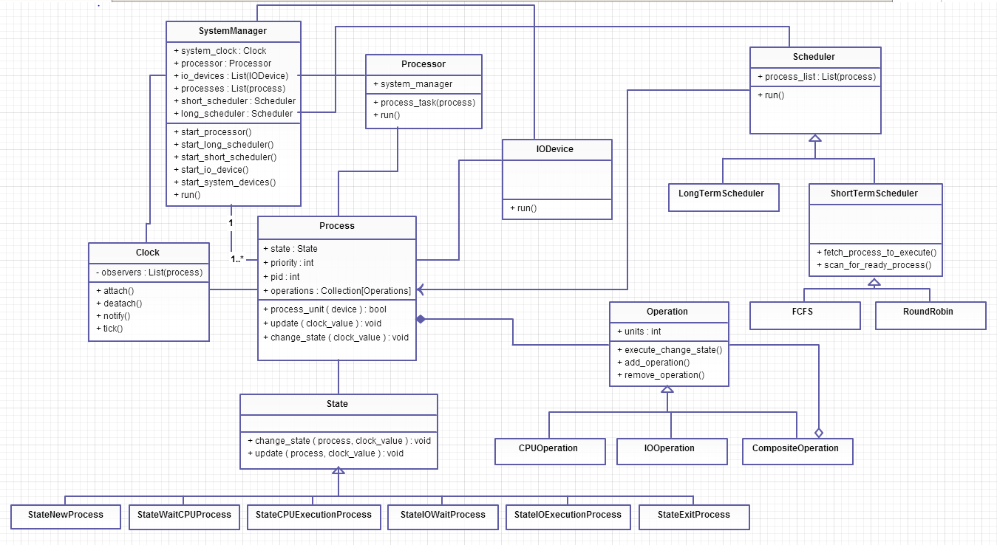

Slide 62
Object Oriented Design
Tasks:
Define the behavior of the objects (assign responsibilities)
Define the internals of the object
Design Pattern: a pattern is a named problem/solution pair that can be applied in a given context.
Patterns are formalized best practices that the programmer can use to solve common problems when designing an application or system.

Slide 63
GRASP
General Responsability Assignment Software Patterns
These are principles which consist of guidelines for assigning responsability to classes.
Information Expert
Creator
High Cohesion
Loose Coupling
Controller
Indirection
Polymorphism
Pure Fabrication
Protected Variations

Slide 64
Information Expert
Problem: What is the general principle to assign responsibilities to objects?
Solution: Assign the responsibility to the class which has the necessary information to solve the problem.
Example:
Which class should be the one to calculate the total time of a process?
Given that the object process holds information about its start time and return time, it makes sense to assign the responsibility to it.

Slide 65
Creator
Problem: Who should be responsible for the creation of new instance of a given class?
Solution: Assign to the class B the responsibility of creating instances of class A if:
B aggregates objects of A
B contains objects of A
B registers instances of objects A
B has all the initialization information for objects A (information expert)
Example:
Which class should create instances of the scheduler?

Slide 66
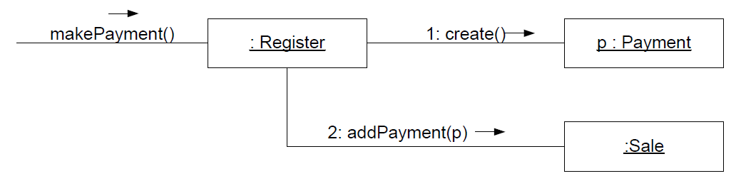
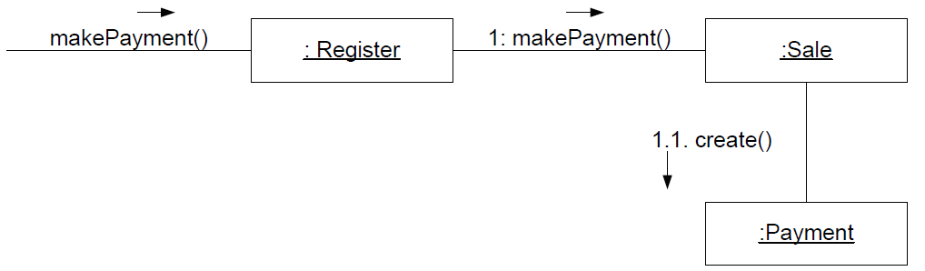
Loose Coupling
Problem: How to achieve low dependency between the classes and a higher reuse potential of each module?
Solution: assign a responsibility in such a way the coupling stays as low as possible.
Notes:
Give the example of Register, Sale, and SaleLine

Slide 67
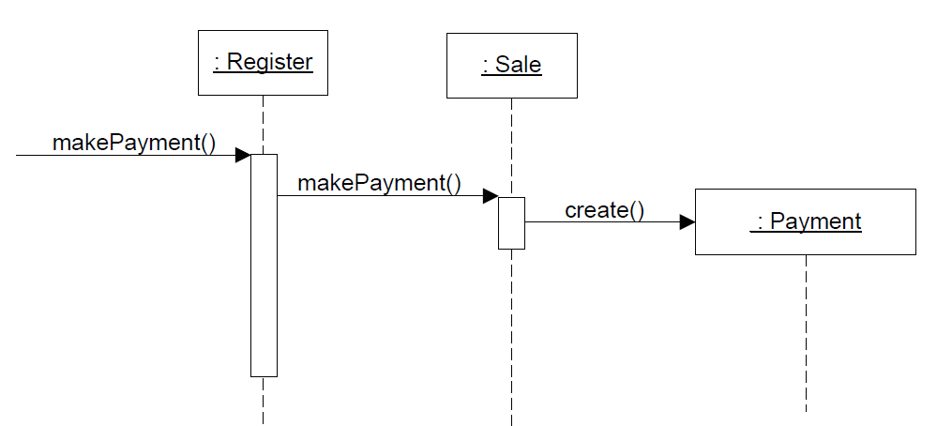
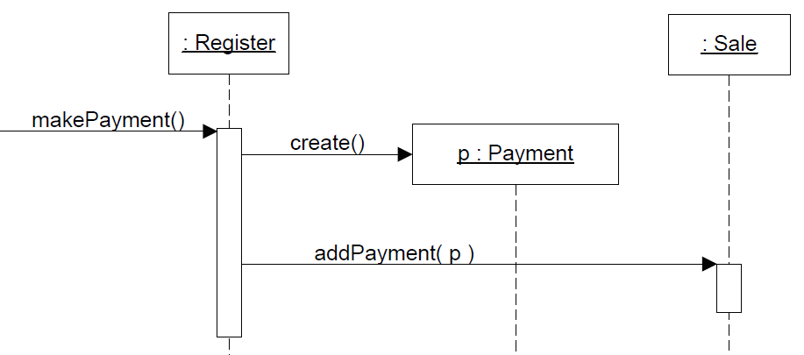
High Cohesion
Problem: How to keep complexity manageable?
Solution: Assign a responsability so that cohesion remains high
Register should be a dispatcher of operations without the need to know each operation in detail.

Slide 68
Controller
Problem: Who should be responsible for handling input system events?
Solution:
A class that represents the overall system (facade)
A class that represents a Use Case Scneario

Slide 69
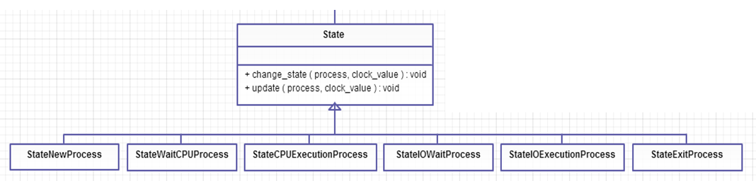
Polymorphism
Problem: How to handle alternatives based on type?
Solution: Assign responsibility to the types for which the behavior varies using polymorphic operations.

Slide 70
Fabrication
Problem: what object should have the responsibility when you do not want to violate High Cohesion and Low Coupling but solutions offered by other principles are not appropriate?
Solution: create a new auxiliar class and assign the responsibility to it
Notes:
The DB or UI Facade example

Slide 71
Indirection
Problem: Where to assign a responsibility, to avoid direct coupling between two components?
Solution: create a new object to mediate between other components or services so that they are not directly coupled.

Slide 72
Protected Variations
Problem: How to design objects, subsystems, and systems so that the variations in these elements does not have an unesirable impact on other elements?
Solution: Identify points of variation and create interfaces around them.

Slide 73
TDA
Tell-Don't-Ask is a principle that helps people remember that object-orientation is about bundling data with the functions that operate on that data. It reminds us that rather than asking an object for data and acting on that data, we should instead tell an object what to do. This encourages to move behavior into an object to go with the data.

Slide 74
Design Patterns
Creational: deal with object creation mechanisms
Abstract Factory
Factory Method
Builder
Singleton
Prototype
Structural: deal with composition of classes
Adapter
Composite
Decorator
Facade
Bridge
Flyweight
Proxy

Slide 75
Design Patterns
Behavioral: interacion of objects
Chain of responsibility
Command
Visitor
Iterator
Mediator
Memento
Null Object
Observer
State
Strategy
Template

Slide 76
Singleton Pattern
Sometimes you only need one instance of a class throughout the entire lifetime of a program.
The singleton design pattern allows you to create only one instance of data.
Use cases:
Need to control concurrent access to shared resource
Global point of access for resources
Examples:
The logging class
Persistence facade
File manager

Slide 77
Classic Singleton
class Singleton(object):
def __new__(cls, *args, **kwargs):
if not hasattr(cls, 'instance'):
cls.instance = super(Singleton, cls).__new__(cls, *args, **kwargs)
return cls.instance

Slide 78
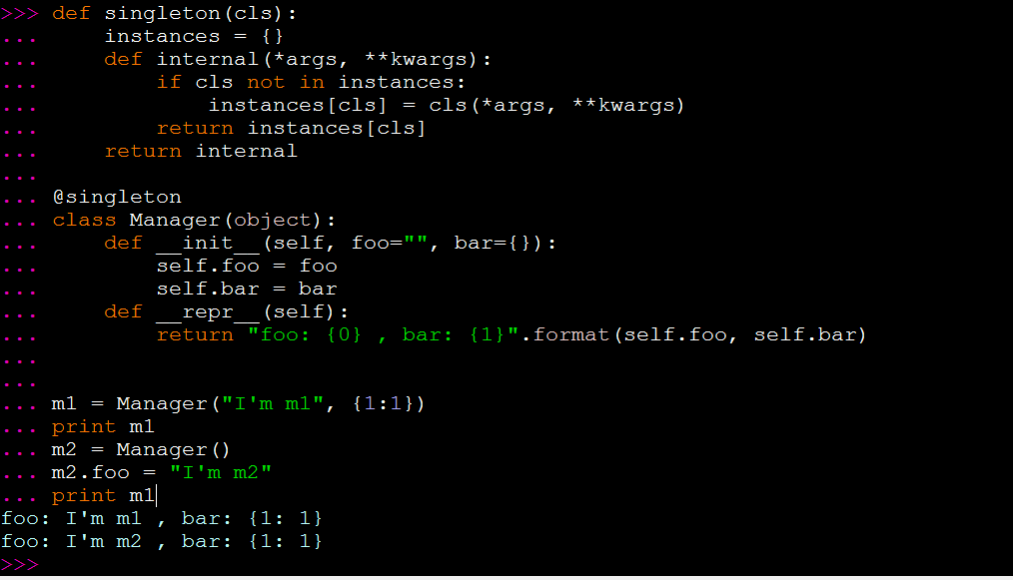
Singleton decorator

Slide 79
FactorY
A factory is a class for creating other objects.
Why factories instead of using direct object instantiation?
Factories provide loose coupling, separating object creation from using specific class implementation.
A class that uses the created object doesn’t need to know exactly which class is instantiated.
The factory can reuse existing objects instead of creating new instances (Pool)

Slide 80
Factory (Craig Larman)
Problem: Who should be responsible for creating objects when there are special considerations, such as complex creation logic, a desire to separate the creation responsibilities for better cohesion, and so forth?
Solution: create a Pure Fabrication object called Factory that handles the creation.

Slide 81

Factory Example

Slide 82
Factory Method
Factory method is a GoF pattern which consists of defining an interface for creating an object, but let subclasses decide which specific class to instantiate. Factory Method lets a class defer instantiation to subclasses.
Example: tool for accessing web resources using HTTP or FTP protocol
While the most common protocol to access web resources is HTTP, there are resources only available through FTP.
This application is able to get a file list on servers with FTP and HTTP using the Factory Method pattern.

Slide 83

Factory Method

Slide 84
Composite
Compose objects into tree structures to represent part-whole hierarchies. Composite lets client treat individual objects and composition of objects uniformly.
Problem: How to treat a group or composition structure of objects the same way (poly-morphically) as a non-composite (atomic) object?
Solution: Define classes for composite and atomic objects so that they implement the same interface

Slide 85
Composite
When to use it?:
When you need to represent part-whole hierarchies of objects.
When you want a client to be able to ignore the difference between compositions of objects and individual objects. Client will treat all objects in the composite structure uniformly.

Slide 86

Composite Example

Slide 87

Observer

Slide 88

State

Slide 89
New-Style vs Old-Style
Traditionally, Python treated built-in types differently from user defined classes. Simple features worked the same between the two, but more complex usage revealed subtle differences that could be quite difficult to track down.
Classes could be makerd as new-style by inheriting from the built-in object

Slide 90
Types, Classes, objects
Everything is an object
Any classes that we define are objects.
Instances of those classes are objects as well
Numbers, strings and even functions are objects.
class = type <–> type = class
There are Type objects and Non-Type objects
Type objects are those from which we can get an instance. They can also be subclassed.
Non-Type objects correspond to concrete instances. We cannot create an instance from them, and they cannot be subclassed either. (We can’t create an instance from a 2)

Slide 91

Types, Classes, Objects
<type> ‘object’> is an instance of <type ‘type’>
<type ‘object’> is a subclass of no object
<type ‘type’> is an instance of itself
<type ‘type’> is a subclass of <type ‘object’>

Slide 92

Types, Classes, objects

Slide 93
ObjectS Creation
When we define a new class, we are creating a new object by subclassing.
When we use the operator (), we are creating an object by instantiating an existing object. That existing object must be a type.
When using instantiation, we ‘re specifying the type, but how does Python know which type to use when subclassing?
It looks at the specified base class and uses its type as the type for the new object.
That can be changed using the __metaclass__ attribute

Slide 94

Metaclasses, classes, Instances

Slide 95
Metaclass
Any class whose instances are themselves classes, is a metaclass.

Slide 96

Metclasses

Slide 97
Metaclasses
We can subclass “type” with normal objected oriented techniques and class syntax to customize it.
type is a class that generates user-defined classes.
Metaclasses are subclasses of the type class.
Class objects are instances of the type class, or a subclass thereof.
Instance objects are generated from a class.
To control the wat classes are created and augment their behavior, we need to specify that a user-defined class be created from a user-defined metaclass instead of the normal type class.

Slide 98
Metaclasses
The python class statement runs its nested block of code to create its attributes (def(s) and class attributes) inside a namespace dictionary (__dict__) corresponding to the class’s local scope.
Then, at the end of the class statement, Python calls the type object to create the class object:
class = type(classname, superclasses, attributedict)
The type object defines a __call__ operator overloading method that runs two other methods when the type object is call:
type.__new__(typeclass, classname, superclasses, attributedict)
type.__init__(classobj, classname, superclasses, attributedict)
Type creates the class object not the instance object (None-type)

Slide 99

Class __dict__
Process = type("Process", (object,), {'priority': 0, 'pid' : 0, 'execute' : execute, '__module__' : '__main__'} )

Slide 100
Metaclasses
Metaclasses can hook into __new__ and __init__ to manage the class at creation time. Both run at the the of the class statement, before any instaces are made.
__new__ should be implemented when you want to control the creation of a new object, eg: change the bases tuple.
__init__ should be implemented when you want to control the initialization of the new object after it has been created.
Metaclass can also hook into __call__ method. In this case however, the class is already created, and it will take control when the class instance (not the metaclass) gets “called”

Slide 101


Slide 102


Slide 103

Singleton Metaclass

Slide 104
When to use metaclasses?
Metaclasses are deeper magic than 99% of users should ever worry about. If you wonder wheter you need them, you don’t (the people who actually need them know with certainty that they need them, and don’t need an explanation about why)

Slide 105
References
http://www.aleax.it/gdd_pydp.pdf
http://www.cafepy.com/article/python_types_and_objects/python_types_and_objects.html
http://www.slideshare.net/gwiener/metaclasses-in-python
https://docs.python.org/2/library/
https://speakerdeck.com/kitanata/superadvancedpython
http://eli.thegreenplace.net/2011/08/14/python-metaclasses-by-example/
http://stackoverflow.com
http://www.programiz.com/
Pro Python “Advance coding techniques and tools” – Marty Alchin – Apress
Learning Python, 5th Edition – Mark Lutz
Applying UML and Patterns: An Introduction to Object-Oriented Analysis and Design and Iterative – Craig Larman
Design Patterns: Elements of Reusable Objected-Oriented Software
Learning Python Design Patterns – Gennadly Zlobin

Slide 106


